Slide 1
Gandhinagar Institute of Technology
HR Management System
Guided by:
Prof. Swapnil Panchal
Prof. Krishna Hingrajiya
Prof. Mitul Maniar
Proposed by:
Varun Bhat (140120107016)
Mihir Hathi (130120111010)
Sneh Mewani (140120116111)
Suraj Zala(140120116113)

Slide 2
PSAR 1: Human resource management system for staffing projects
Patent No: US 6049776
Inventors: Donnelly Joseph S., Robinson Morris G., Reese James R.
Assignee: Unisys Corporation
Country: United States
IPC class: G06Q 10/06 ; G06Q 10/10

Slide 3
PSAR 2: Time clock system including scheduling payroll and productivity analysis capability
Patent No: US4819162 A
Inventors: Webb Jr. Frederick W., Almendinger Allen D., Bright Keevin L., Hendren Kenneth J., Petersen Donald D., Carlson Wesley R.
Assignee: Time Management Corporation
Country: United States
IPC class: G06Q 40/00 ; G06Q 10/10 ; G07C 1/10

Slide 4
PSAR 3: System and method for analyzing work requirements and linking human resource products to jobs
Patent No: US6070143A
Inventors: Barney Matthew F., Pearlman Kenneth, Harkey Scott T.
Assignee: Lucent Technologies Inc.
Country: United States
IPC class: G06Q 10/06

Slide 5
PSAR 4: System for recruiting candidates for employment
Patent No: US20020128894A1
Inventors: Farenden Rose Mary
Assignee: Ford Motor Company
Country: United States
IPC class: G06Q 10/10 ; G06Q 10/06

Slide 6
PSAR 5: System for scheduling classes and managing educational resources
Patent No: US20080057482A1
Inventors: Snyder Jonathan Scott, Robert Adrian Bradford
Assignee: Snyder Jonathan Scott, Robert Adrian Bradford
Country: United States
IPC class: G06Q 50/20 ; G06Q 10/10 ; G06Q 10/06 ; G09B 11/00 ; G09B 7/02

Slide 7
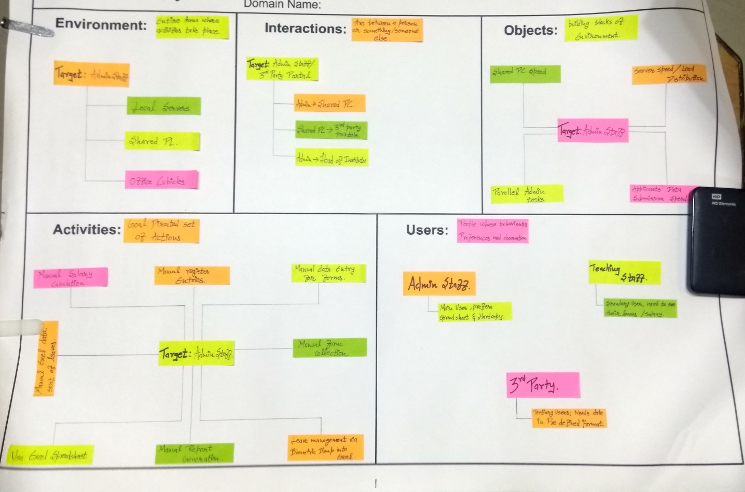
AEIOU Sheet

Slide 8
Activities
Target: Admin Staff
Manual register entries
Manual salary collection
Manual data entry for forms
Manual excel data sort of leaves
Manual form collection
Manual report collection
Leave management via biometric dump into Excel

Slide 9
Environment
Target: Admin Staff
Local servers
Shared PC
Office Cubicles

Slide 10
Interactions
Target: Admin Staff/3rd party portals
Admin -> Shared PC
Shared PC -> 3rd party portals
Admin -> Head of Institute

Slide 11
Objects
Target: Admin Staff/3rd party portals
Shared PC speed
Parallel Admin tasks
Sever speed/load distribution
Applicants’ data submission speed

Slide 12
Users
Admin Staff
Primary users, prefer spreadsheets and hard copies
Teaching Staff
Secondary users, need to view leaves
3rd Party
Tertiary users, need data in pre-defined format

Slide 13
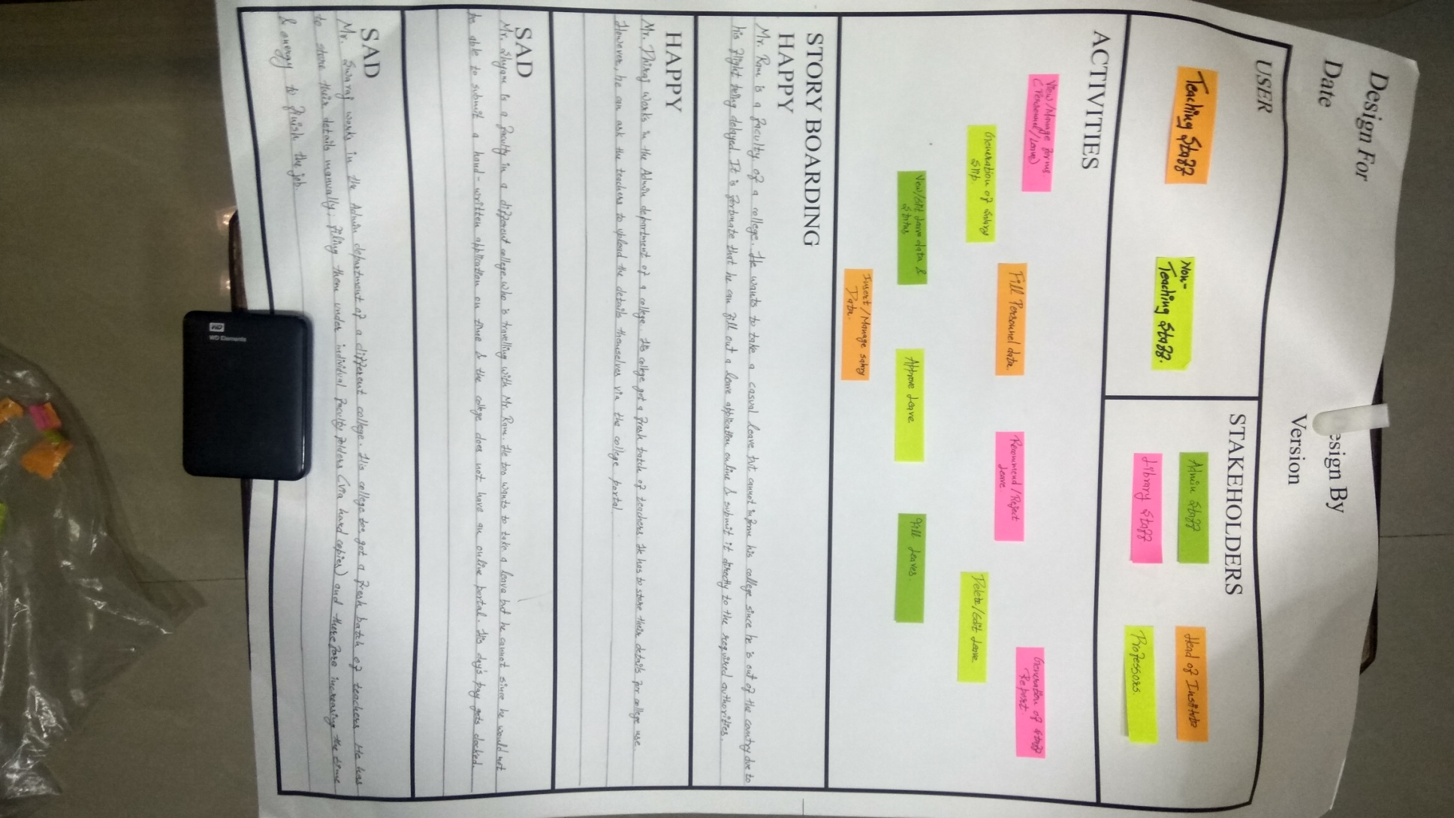
Empathy Mapping

Slide 14
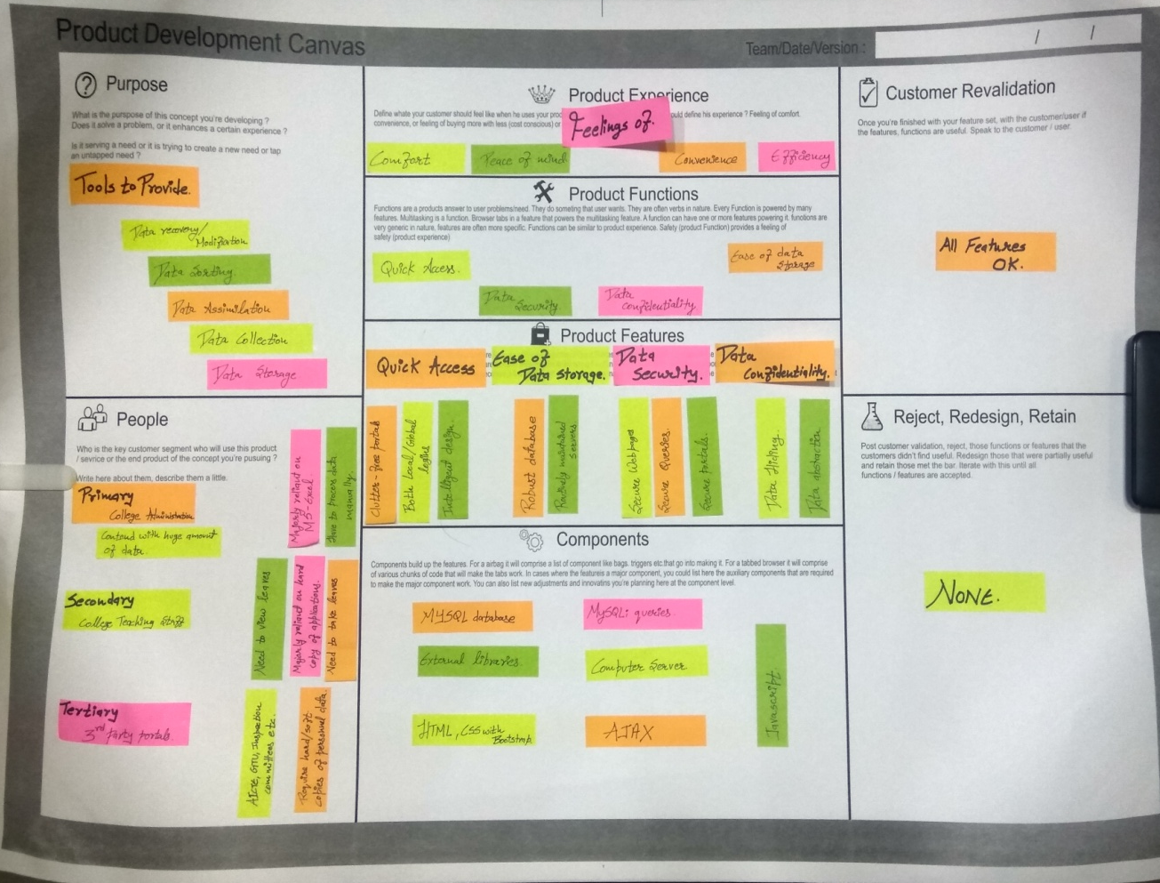
Product Development Canvas

Slide 15
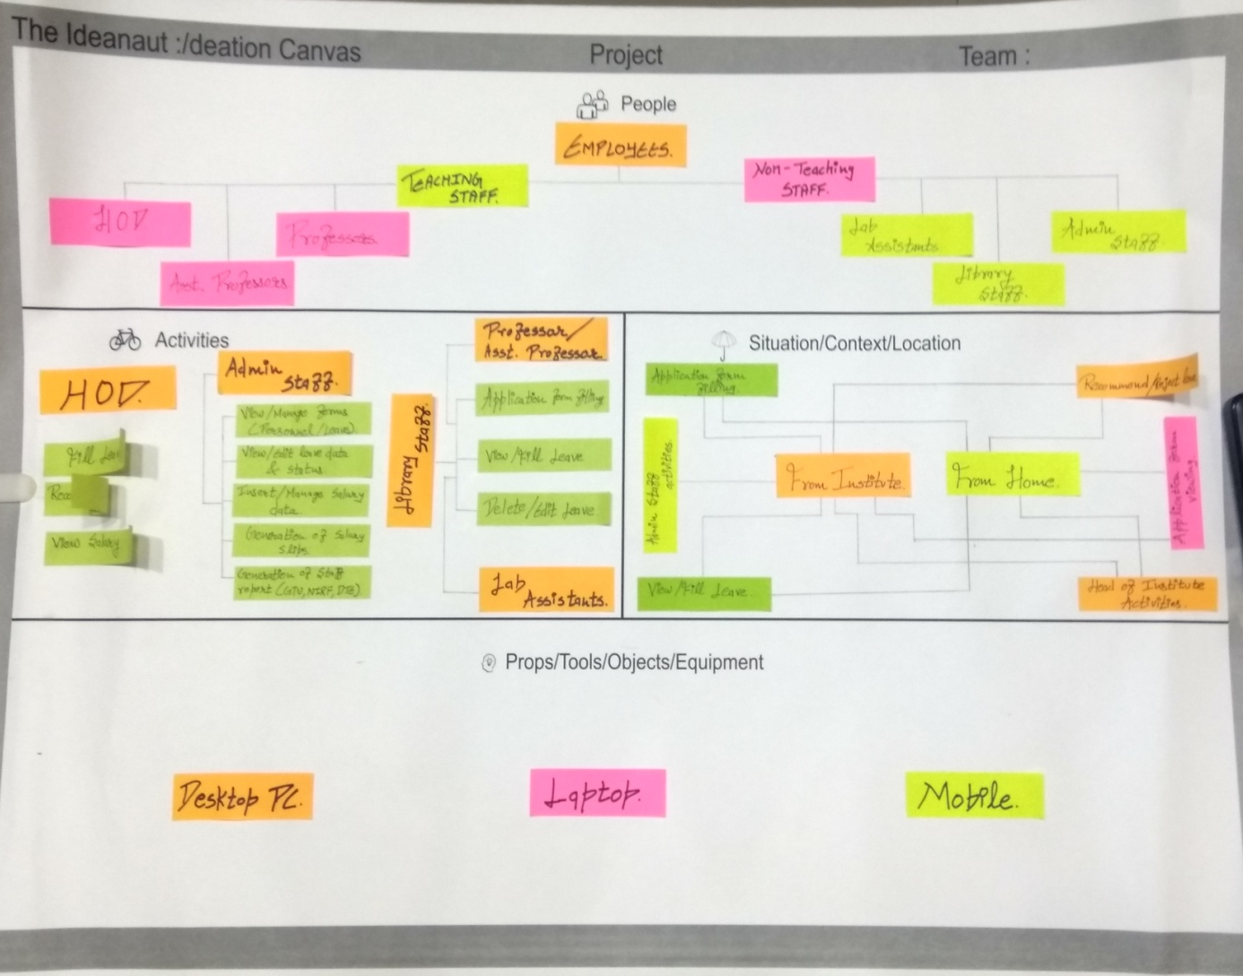
Ideation Canvas

Slide 16
Modules
Login/Registration module
5 Part Faculty data collection form
Leave Module
Pay Module
Data Output Module

Slide 17
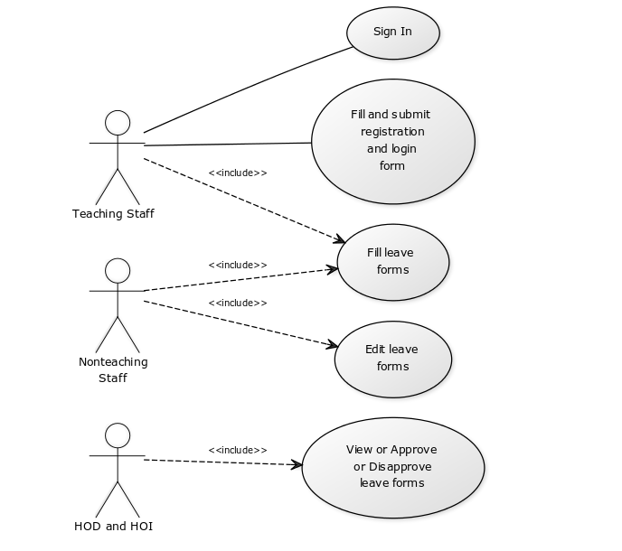
Usecase diagram

Slide 18
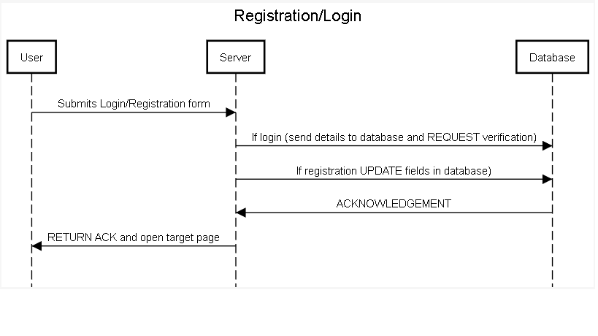
Sequence diagrams

Slide 19
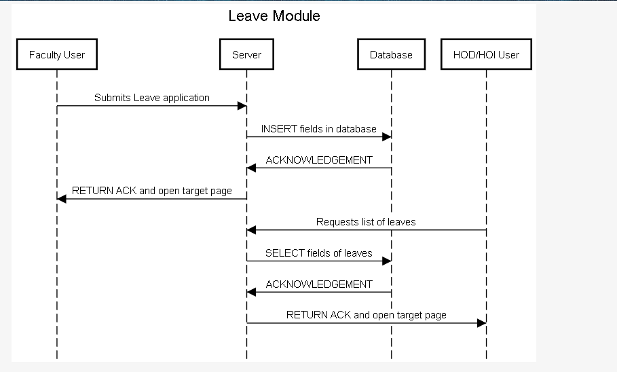
…contd

Slide 20
End

